Slide 1
CST8117 Cross Platform Web Design
Assignment 2
The Style Guide

Slide 2
The Style Guide
Welcome to Puppedia
Roles:
Team leader: Steven
Frontend UI designer: Lynn
Frontend designer: Jacky
Frontend developer: Steven

Slide 3
The Client of Website
Design and build Puppedia website.
The target customer is:
Dog lovers
Our slogan:
Your dog decision guide

Slide 4
The Style
Our website is inspired by Wikipedia but is designed specifically for dog enthusiasts. As our slogan states, we aim to assist people considering getting a dog by providing information about various dog breeds. Users can also find breed-specific advice on our site.
We chose colors that closely resemble the fur colors of dogs as the theme for our site. Contract are created with different colors applied between sections.

Slide 5


1. Typography - Header
Font: “Bree Serif”
Font size: 34px (<h1> tag)
Font weight: bold
Color:
#13348E (nav text)
#000000 (section header)

Slide 6
1. Typography - Content
Font: “PT Sans”
Font size: 16px (<p> tag)
Font weight: regular
Color:
Puppedia

Slide 7

2. Logotypes
Size: (1200 x 1200 px)

Slide 8
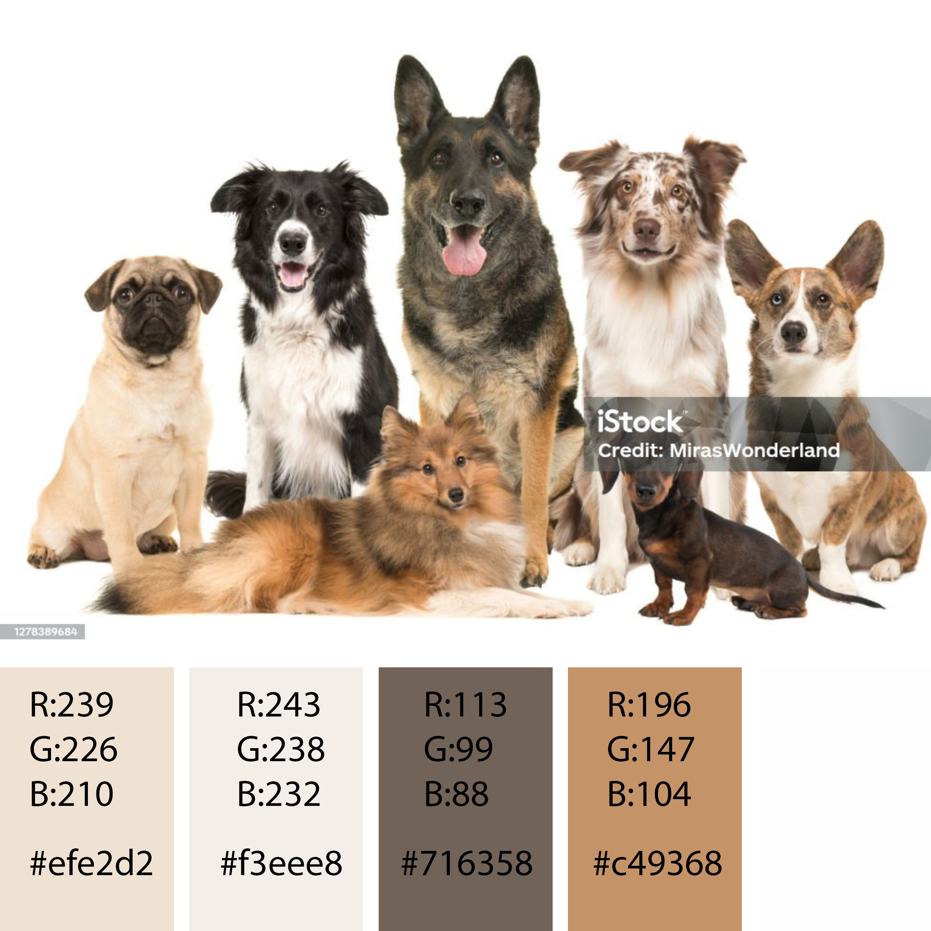
3. Color palette

Slide 9
3. Color palette
#6c584c
#8a817c
#efe2d2
#f3eee8
#f1f2eb
#f6f6f2
#13348e
#3273F6
#F64C72
#ffd700

Slide 10
3. Color palette
#6c584c
Pagination hover status
Pagination active status
#8a817c
Dog card text
Pagination static status
#efe2d2
Dog advice container background color
#f3eee8
Body background color
#f1f2be
Dog cards’ background color
#f6f6f2
Section div background color
#13348e
Nav items color
#F64C72
Nav items and dog cards’ hover status color
#3273F6
Form slider and buttons color
#ffd700
Dog parameter stars colors
#6c584c
#8a817c
#efe2d2
#f3eee8
#f1f2eb
#f6f6f2
#13348e
#3273F6
#F64C72
#ffd700

Slide 11

4. Platform - Responsive layout
Responsive layout rules
Fixed Nav in large monitors (50px)

Slide 12
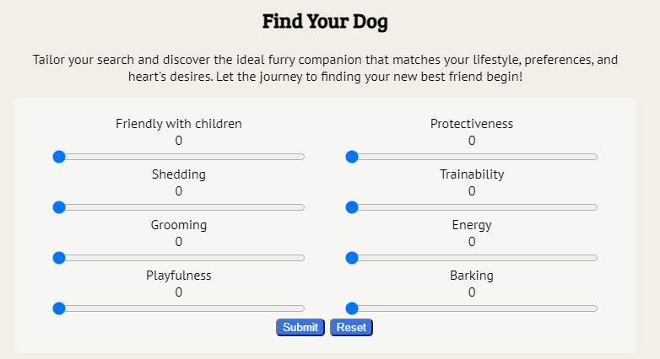
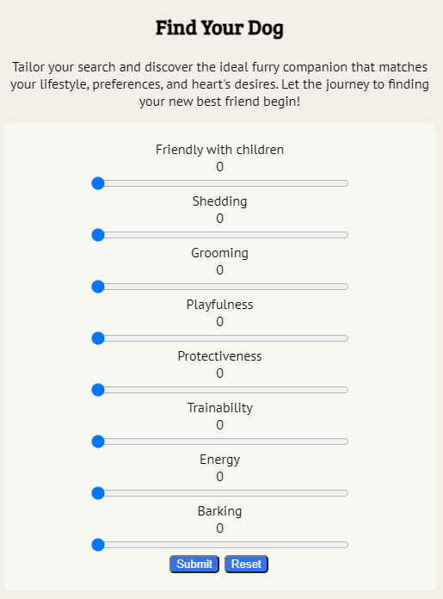
4. Platform - Responsive layout
Form in one column in mobile devices
(max-width: 610px)
Responsive layout rules
Form from two column in large monitors

Slide 13
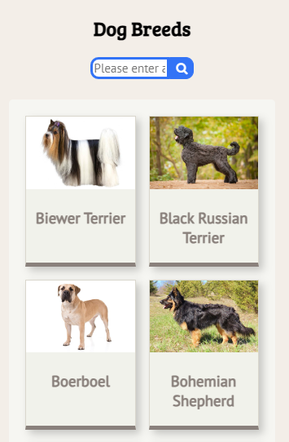
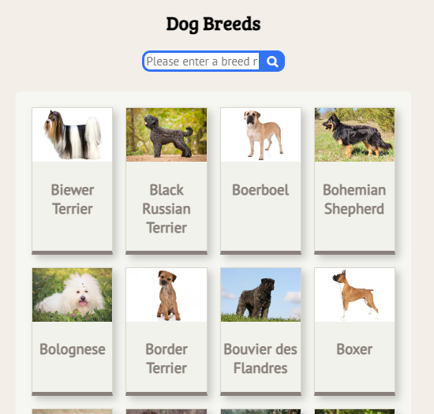
4. Platform - Responsive layout
Dog Breeds session with 2 to 8 grid in small mobile
Responsive layout rules
Dog Breeds session with 4 to 4 grid in large monitors

Slide 14
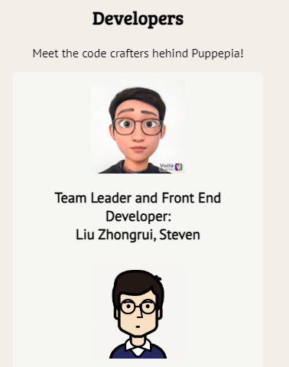

4. Platform - Responsive layout
Responsive layout rules
Developer session with grid (1fr) in large monitors
Developer session with grid (3, 1fr) in large monitors

Slide 15

5. Semantic design guide
Index page – signature div design guide
div signature background color sequence
#dbd3be
#9c813c
div signature font color sequence
#775a0e
With white shadow (2px)
#fff
With grey shadow #333

Slide 16
5. Semantic design guide
Header design guide
header {
text-align: center;
font-family: 'Marck Script';
font-weight: bold;
font-size: 50px;
box-shadow: grey;
color: #775a0e;
}
@media screen and (max-width:760px) {
header {
text-align: center;
font-family: 'Marck Script';
font-weight: bold;
font-size: 30px;
box-shadow: grey;
color: #775a0e;
}

Slide 17
5. Semantic design guide
Nav design guide
.navbar {
display: flex;
flex-direction: row;
justify-content: space-evenly;
}
.navbar a:hover{
margin: 10px;
font-family: 'Marck Script';
font-size: 20px;
color:black;
background-color: white;
cursor: pointer;
}
.navbar, .navbar a{
margin: 10px;
font-family: 'Marck Script';
font-size: 20px;
color: white;
background-color: #775a0e;
}

Slide 18
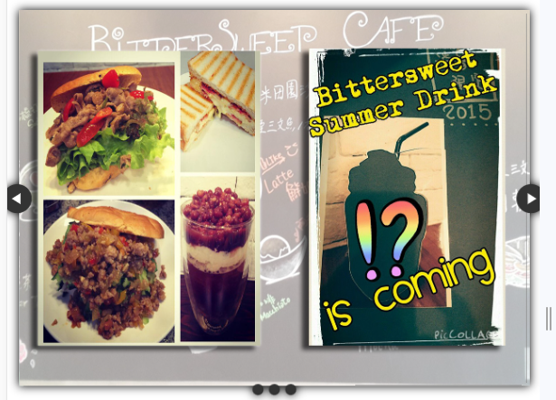
5. Semantic design guide
Main section include carousel design guide

Slide 19
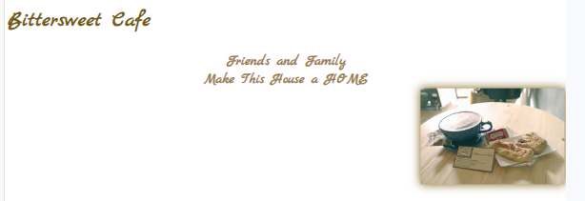
5. Semantic design guide
Main section include bittersweet keyslogan design guide

Slide 20



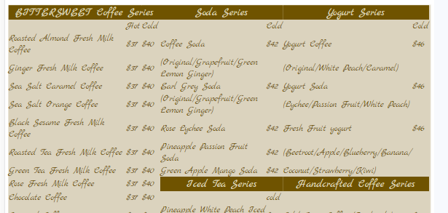
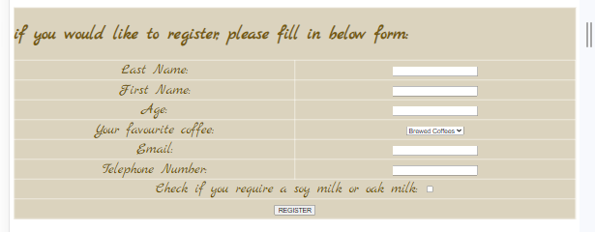
5. Semantic design guide
Main section
Index page include signature design guide
Coffee page include gallery of coffee design guide
Cake page include gallery of cake design guide
Menu page include menu design guide
Contact us page include form and address

Slide 21
5. Semantic design guide
footer design guide
footer, footer a {
background-color: #775a0e;
color: white;
font-family: 'Marck Script';
font-size: 20px;
text-align: right;
}
footer img {
height: 30px;
padding-right: 10px;
float: left;
}
.linkfooter {
text-align: left;
color: white;
height: 40px;
}

Slide 22
6. Website Map
Homepage
Dog Breeds
Care and Advise
Developer
Fing a Dog

